Slide 1

Delivery time
Analysis

Slide 2

Objective
Analyze the delivery time & sorting time based on the given data. By using this data will try to find out the co-relation between delivery time & sorting time

Slide 3
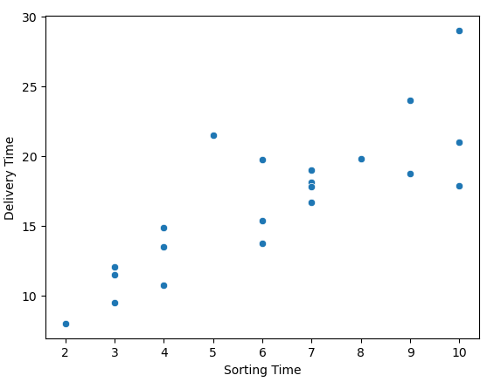
Solution
After analyzing the data we came on the conclusion when sorting time is less delivery time is less. Please refer to below graph
For faster delivery sorting time needs to be reduced.

Slide 4
Business impact
From the data we can say that sorting time creates the big impact on the faster delivery as we need to reduce the delivery time for it we need to have the good sorting system to reduce the sorting time.
Company can make investment to implement the new system will reduce the delivery time in future orders.

